Slide 1


Presented by
Mahbubur Rahman
Lecturer
Department of Computer Science and Engineering(CSE)
Green University of Bangladesh(GUB)

Slide 2
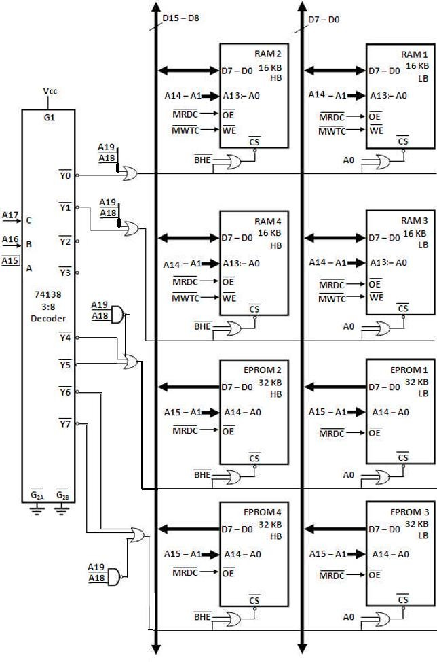
8086 Memory Interfacing

Slide 3
